Slide 1
Battletech Campaign Operation
By: Austin Karingada
Roy Ramirez III

Slide 2
Project Summary
The goal of this application was to create a web application that would allow BattleTech players to create their own military unit for campaign play. Users would be charged a reoccurring monthly payment for access to the tool and the various military units they had created. Non-paid users would have no access to the application.

Slide 3
Main Features of the Application
To take in user inputs from the wizards into a database from there the user can track and keep track of the user items. In this case, keep track of the units the user has and show the upkeep of the units.

Slide 4
Individual Contributions
Rogelio Ramirez: created the mock up for the sign in and sign out pages. Designed the unit model and implemented create/edit/destroy option. Integrate the Unit model to the database using Active Record. Implemented the routing structure to separate logged in and logged out users. Did bug fixes to wizard and got it working
Austin Karingada: Created the wizard mocks up for stages 1-4 and implemented the routing of the wizard pages.

Slide 5
Developing a web application vs. desktop
A web application can be accessed anywhere so long as the user has internet and it can be used on any computer without the need to install it. The data also will be online so it will be backed up. The only drawback being that you need internet so if you are without internet then it will not work.

Slide 6
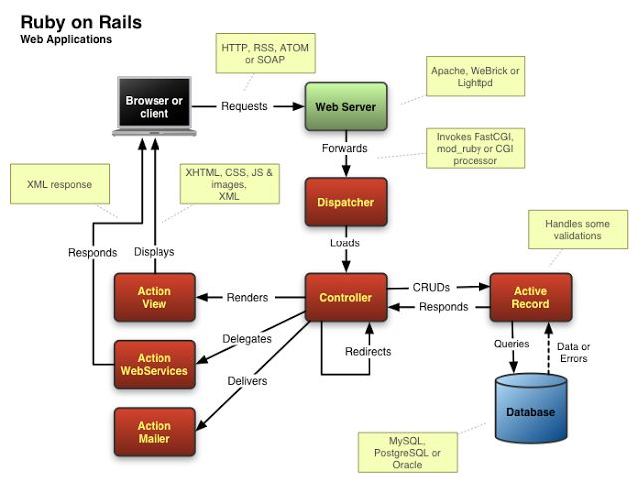
Developing the backend in Ruby on Rails

Slide 7
Benefits of using rails
Time-efficient
Scalable
Promotes bug free devolopment
Cost effective
Secure

Slide 8
Heroku
What is Heroku?
Heroku is a cloud platform that lets users build, deliver and scale apps.
This is the platform we used to deploy the web application.
Process was relatively painless, as long as Postgresql is selected

Slide 9
UI Design
We used Bootstrap to make the UI of the site, why bootstrap?
Bootstrap comes with its own custom CSS and JavaScript files, which are loaded from their recommended content delivery network and we don’t have to keep it updated.
Bootstrap will also allow the application to possible convert to a mobile experience faster and easier.

Slide 10
Database
The local database that ruby on rails used was SQlite3 which we used to store our unit information.
Upon production, the database was changed to PostgreSQL since it was deployed on Heroku.
Biggest issue is making sure that the User is the object that is creating, editing or destroying units to ensure it is recorded in the database.

Slide 11
Class and Database Layout
User | Unit | subUnit
Email: String Encrypted_password: String Id: Integer Role_id: Integer Last_paid: Date Paid: Boolean | User_id: Integer Unit_name: String Unit_type: String Admin_people: Integer Tech_people: Integer Rating: Integer Balance: Double Ocost: Double SubUnits []: SubUnit | Unit_id: Integer SubUnit_Type: String Ammo_cost: Double Spare_cost: Double Fuel_cost: Double Crew: Integer Officers: Integer Rating: Integer Num_of_machines: Integer
Admin_only() Paid() Current() | Operating_cost() Avg_rating() Total_people() | Num_people() Total_cost()

Slide 12
User authentication
User authentication was done by Devise, provided by Mr. Martinez
The Home Controller ensures that if the user is logged in, he is directed to the dashboard.
The Application Controller redirects people to the Dashboard once they log in.

Slide 13
Current Status/ Future Work
The web application is partially functional and most of the features are not yet implemented. The major sections that need to be completed are:
•SubUnit integration
•Complete the Unit Wizard with all the rules.
•Administrator rights
•Billing integration
•UI customization
•Dashboard Responsiveness

